Slide 1
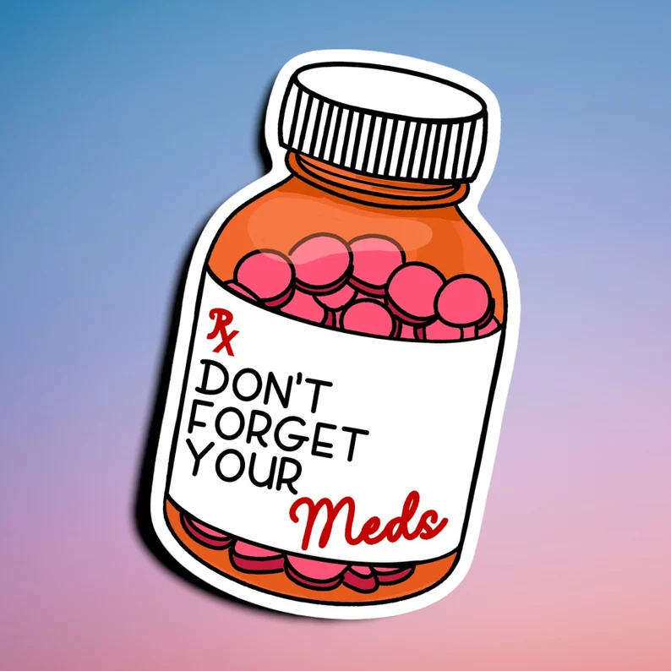

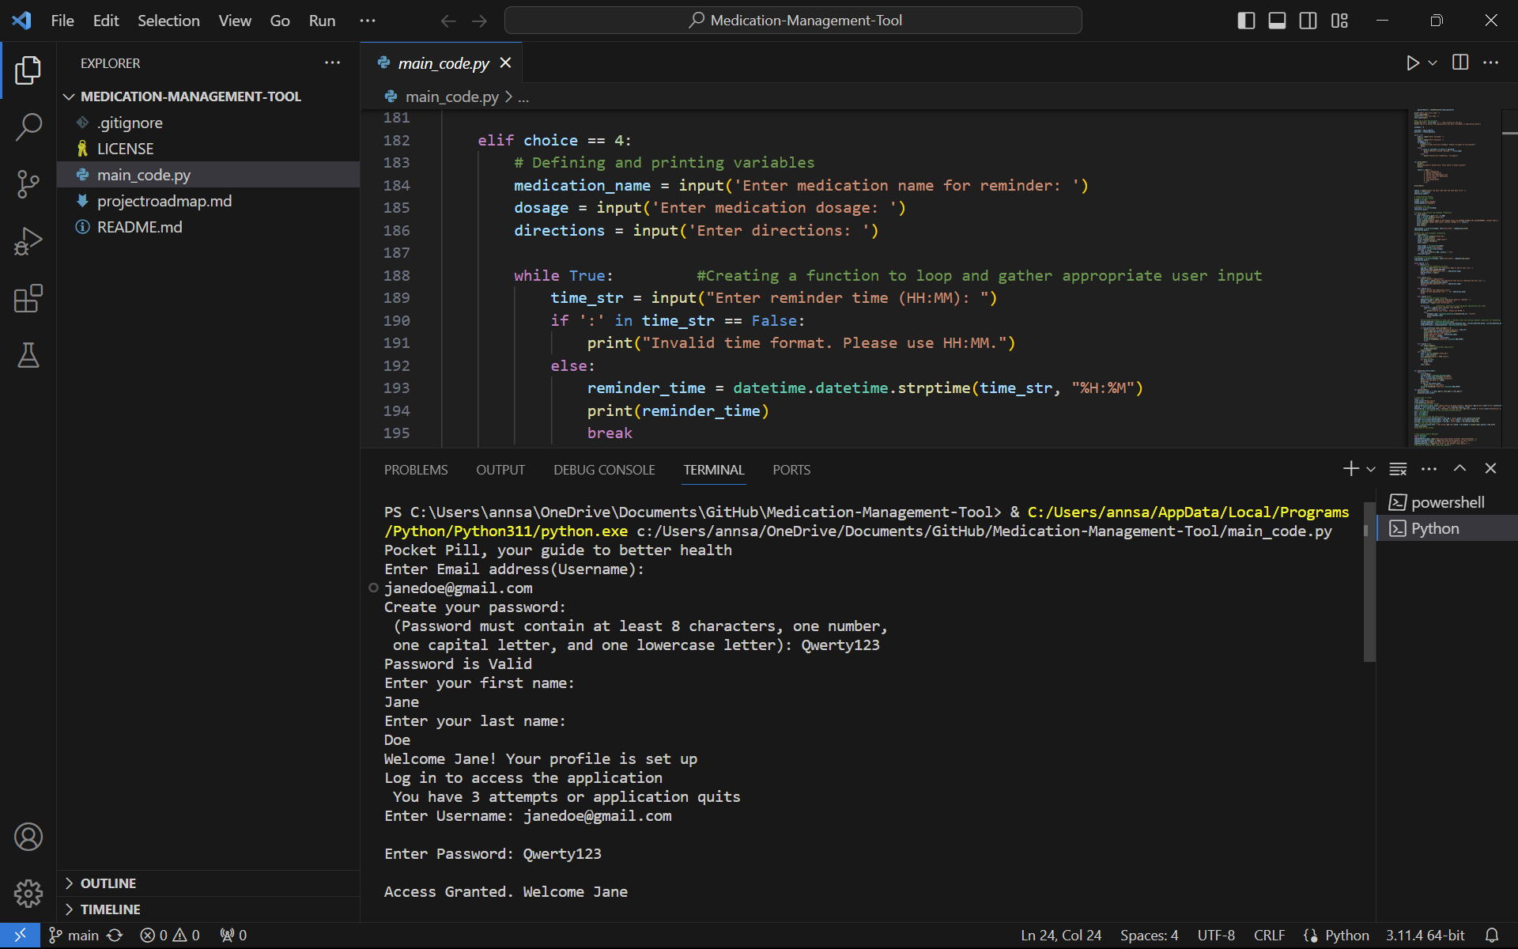
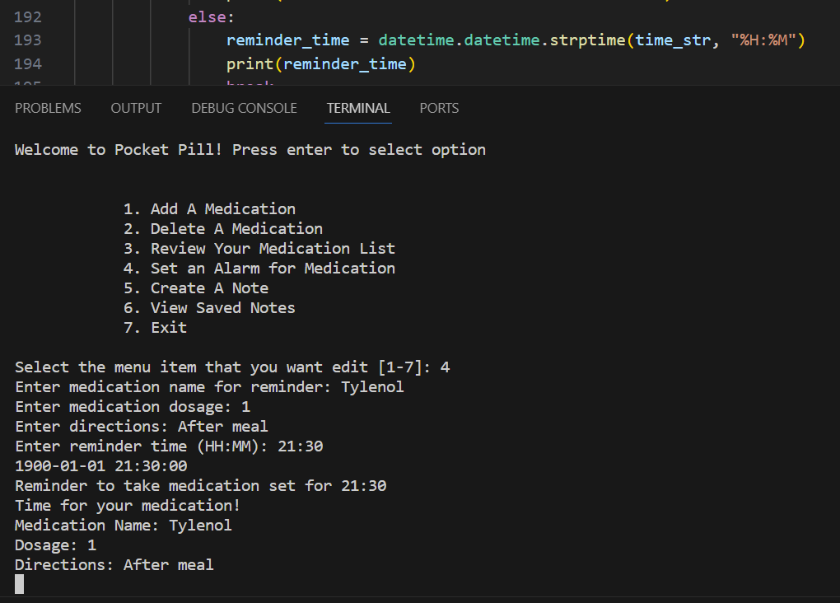
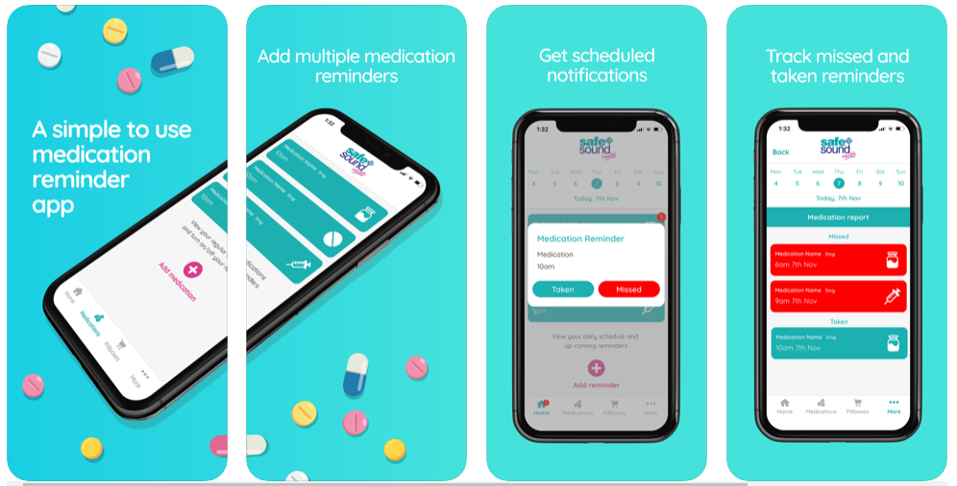
Medication Management Tool - 'Pocket Pill' A personal management tool that allows users to input prescription details and send reminders for when they need to be taken or refilled. This tool is ideal for users with multiple prescriptions to keep track of and aims to help reduce the likelihood of missing doses.
Team Members
Bunmi Simpson (https://github.com/osimpso)
Ann Johnson (https://github.com/rubyann2000)
Shanil McFarlane-Fuller (https://github.com/smcfar18)
Calise Hammonds (https://github.com/calisehammonds)

